Slide 1
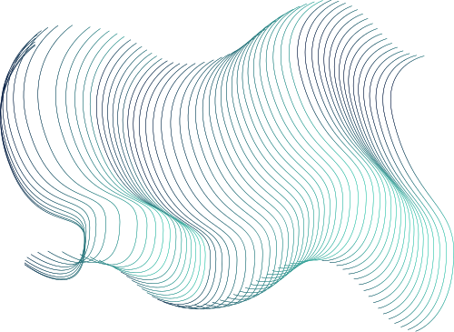

Team 7: Customer Segmentation
Presentations are communication tools that can be used as lectures, speeches, reports, and more. It all depends on the purpose of your presentation.

Slide 2
Introduction
Company Overview
Embarking on our Business Intelligence endeavor, we are immersed in the realm of "Customer and Segmentation" using Company X's extensive dataset. Picture this as a detective story—our mission is to uncover the mysteries of customer behavior and preferences. In our initial phase, we meticulously examined data fields, tables, and connections, piecing together clues like a puzzle to reveal a holistic understanding of customer interactions.
We also sought out hidden gems—potential data sources—to enrich our insights further. Beyond exploration, we ensured the reliability of our findings by scrutinizing data accuracy. This journey is a gateway to informed decision-making, and we eagerly anticipate sharing our discoveries and strategies for smarter business moves ahead.
Notes:
In our project about "Customers and Segmentation," we're diving into Company X's big pile of data to figure out how customers behave and what they like. We started by looking closely at all the information in the dataset, like a detective looking for clues. We wanted to understand things such as what customers buy and how often they shop.
We then worked to identify the main tables and how they connect with each other, like pieces of a puzzle coming together. This is important because it helps us see the big picture of how customers interact with the company.
We also tried to find other places in the dataset that might have important information about customers. It's like looking for hidden treasures that could help us understand customers even better.
Lastly, we checked if the data is trustworthy by making sure it's accurate and complete. Think of it like making sure all the ingredients for a recipe are good before starting to cook.

Slide 3
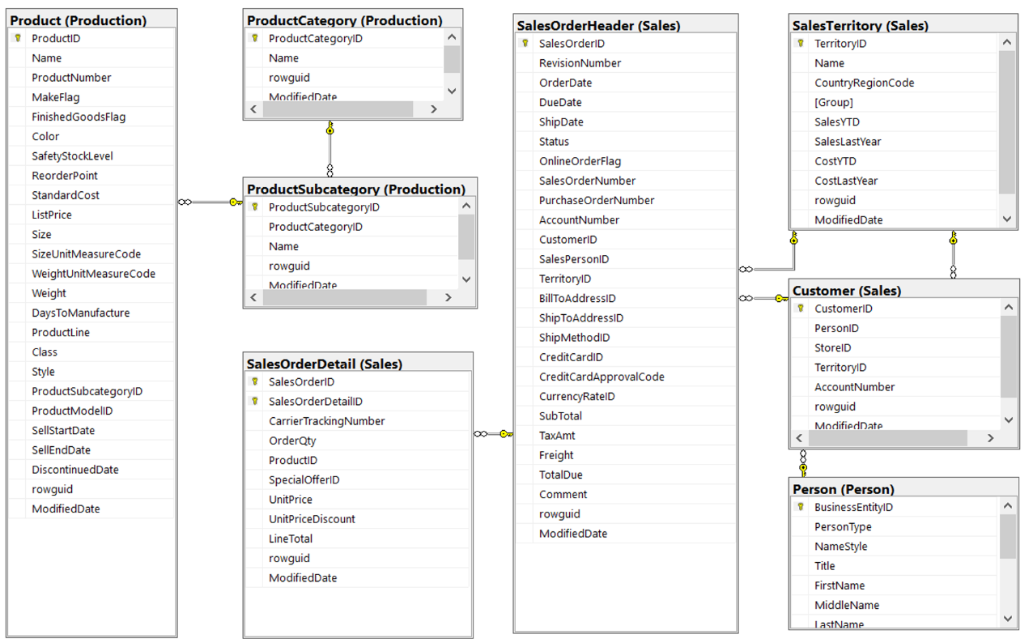
Data Warehouse
design

Slide 4
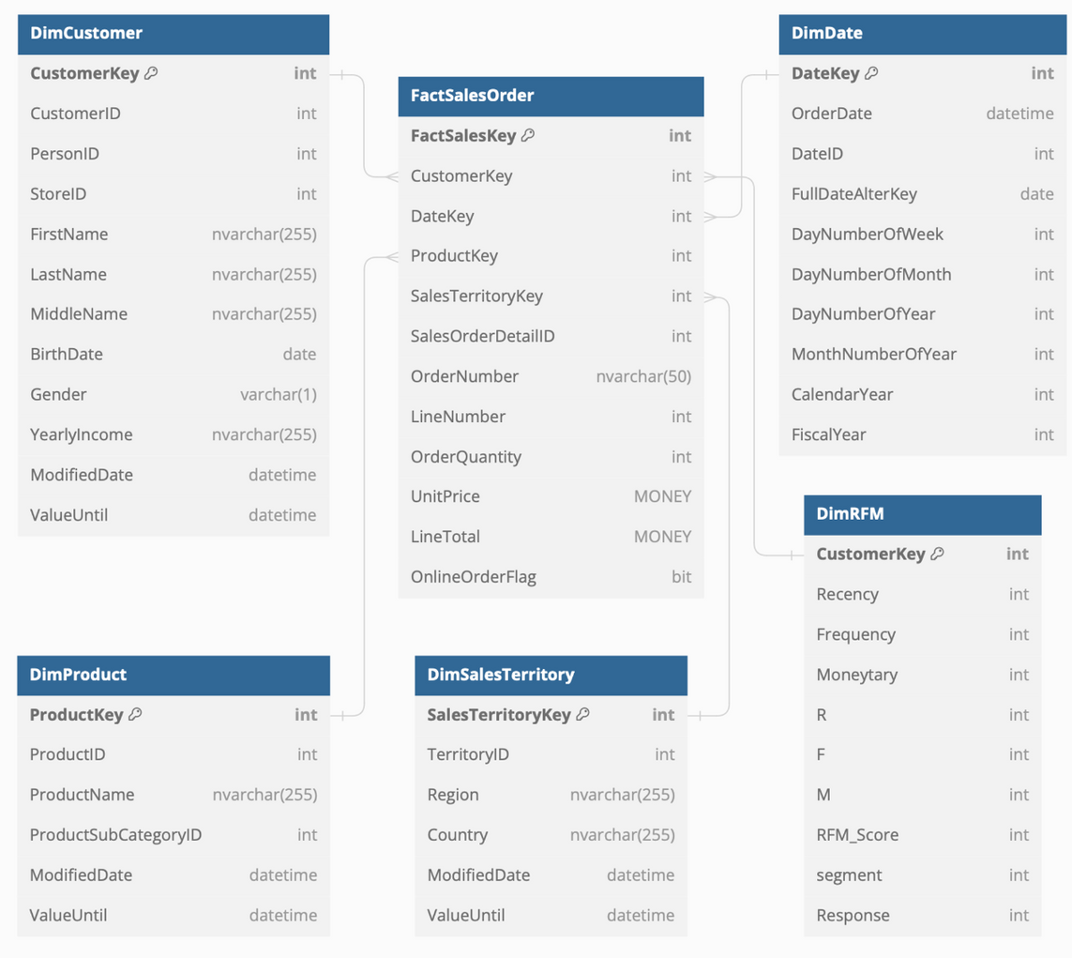
Data Warehouse
design

Slide 5
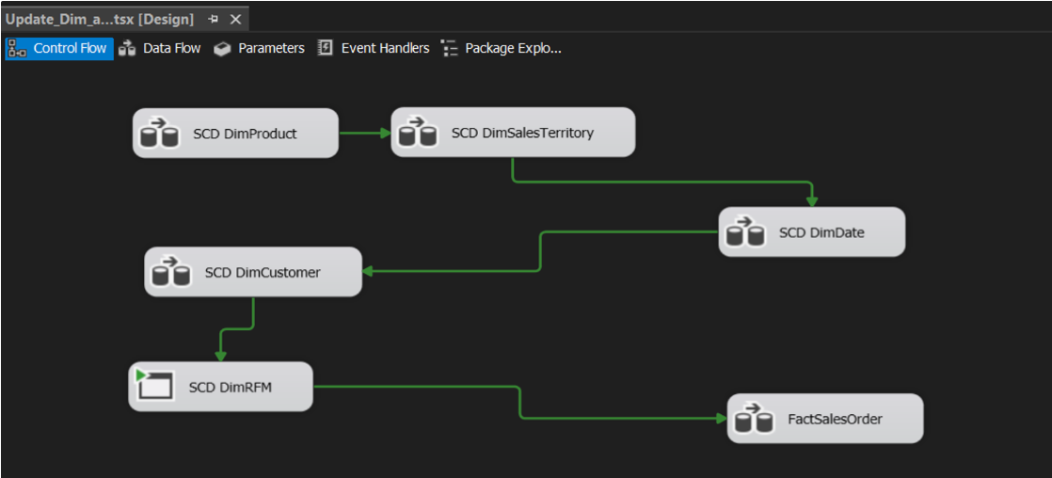
ETL pipeline
All Dimension

Slide 6
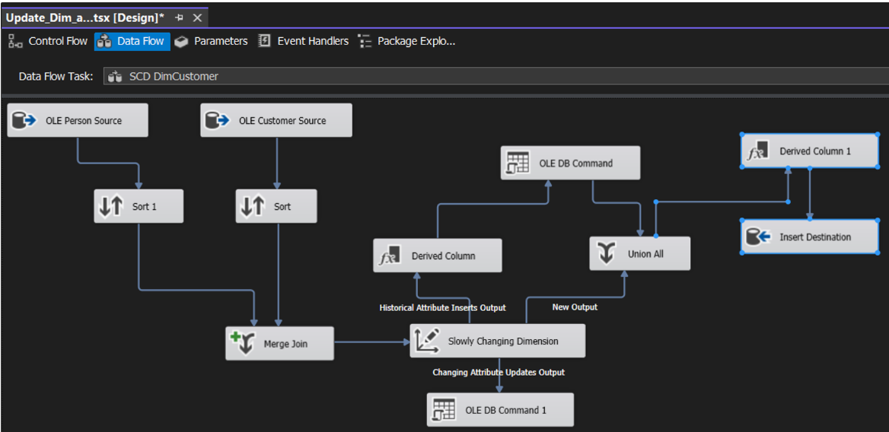
ETL pipeline
All Dimension
Dim Costumer

Slide 7
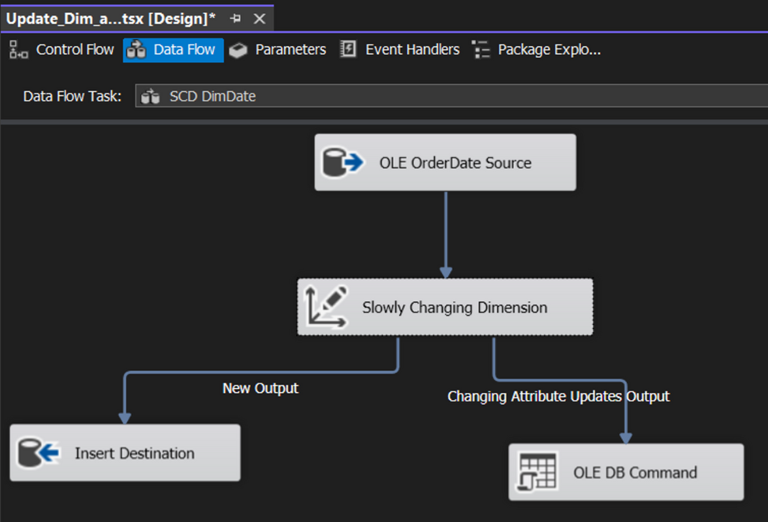
ETL pipeline
All Dimension
Dim Costumer
Dim Date

Slide 8
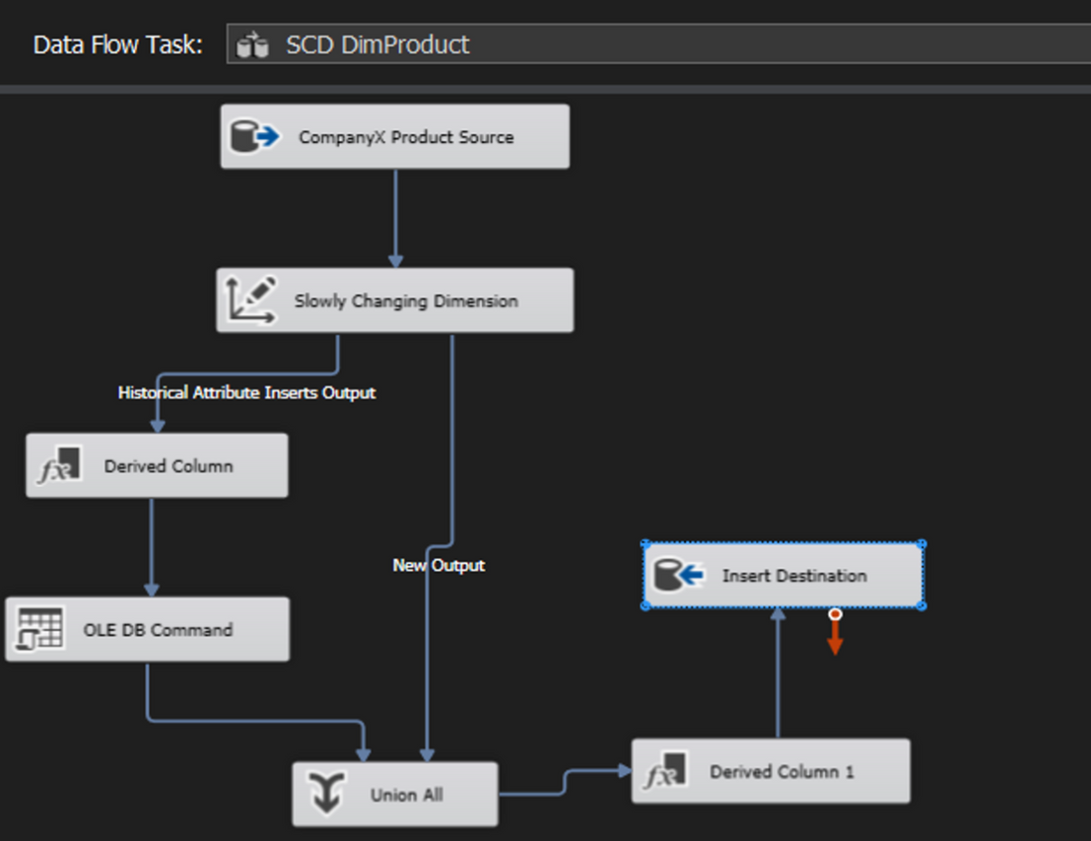
ETL pipeline
All Dimension
Dim Costumer
Dim Date
Dim Product

Slide 9
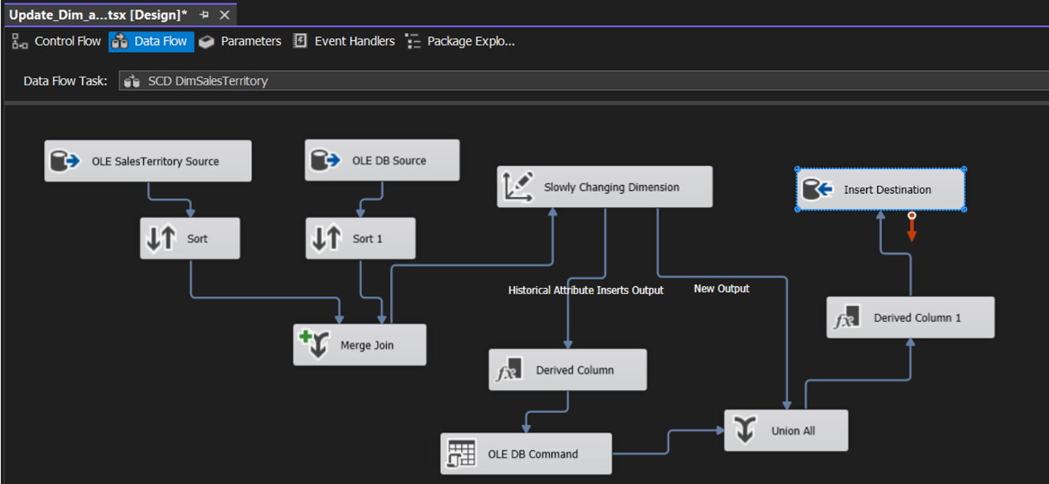
ETL pipeline
All Dimension
Dim Costumer
Dim Date
Dim Product
Dim SalesTerritory

Slide 10

Reference Date (R)
Choose the reference date as 12/1/2013. Calculate the Recency (R) for each customer based on the maximum other_date of each customer.
Categorize customers based on Recency:
If R ≤ 60, assign R = 3.
If 60 ≤ R ≤ 120, assign R = 2.
If R > 120, assign R = 1.
Frequency (F)
Determine Frequency (F) based on the lineNumber (number of units/items/products purchased in a transaction).
Categorize customers based on Frequency:
If F ≤ 3, assign F = 3.
If 3 ≤ F ≤ 6, assign F = 2.
If F > 6, assign F = 1.
Data Mining
technique
Monetary (M):
In this project we using RFM Analysis
Assess Monetary (M) based on the total sale (line_total).
Calculate Line_Total as Other Quantity * Sales amount.
Divide Line_Total into three equal sections and assign rates 1, 2, 3 accordingly.

Slide 11
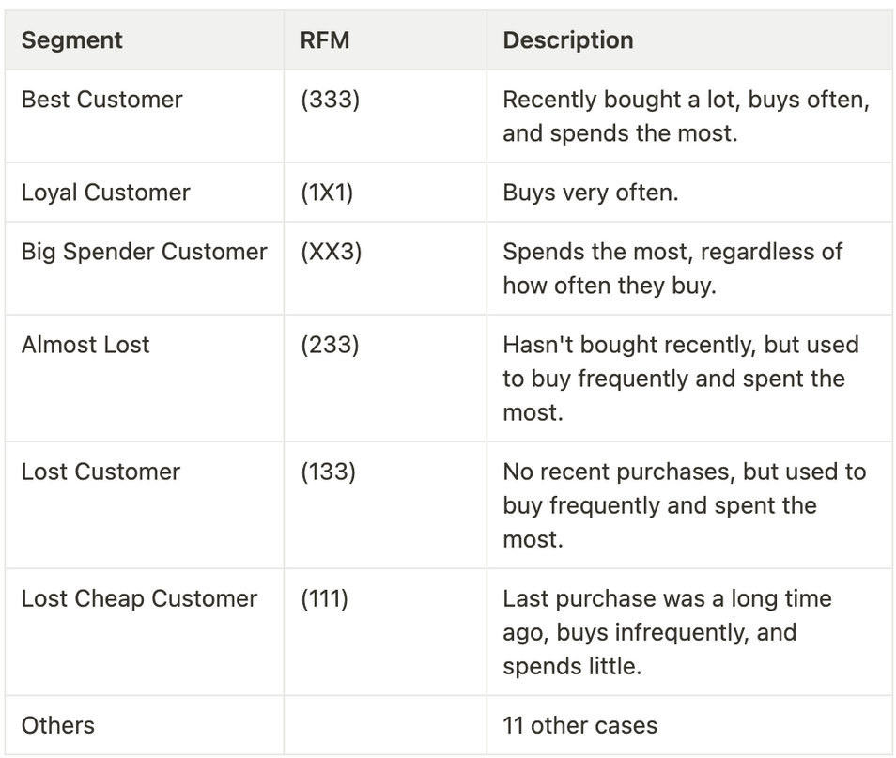
Data Mining
technique
In this project we using RFM Analysis

Slide 12
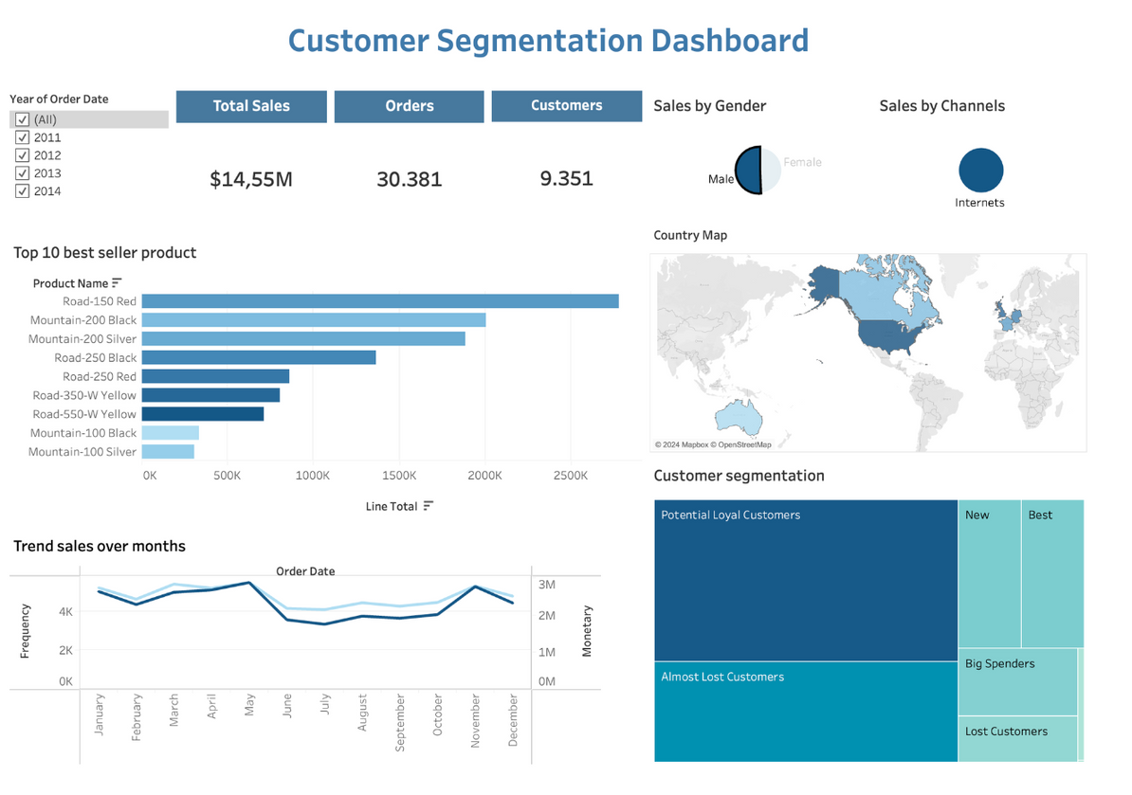
Customer Segmentation Dashboard

Slide 13
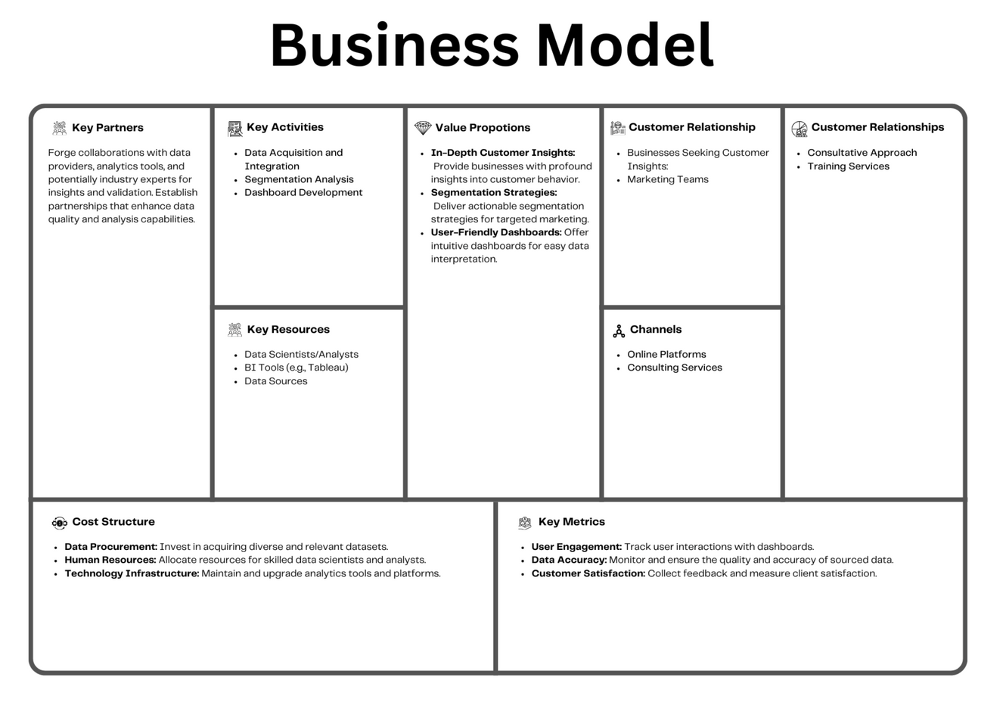
Business Canvas Model

Slide 14
Thank you

